Slide 1




Tooling Scratch
Designing a Collaborative Game-Based Learning System to Infuse Computational Thinking within Grade 6-8 Curricula
Jeff Bender | COMS E6123 Presentation | 3/3/2015

Slide 2
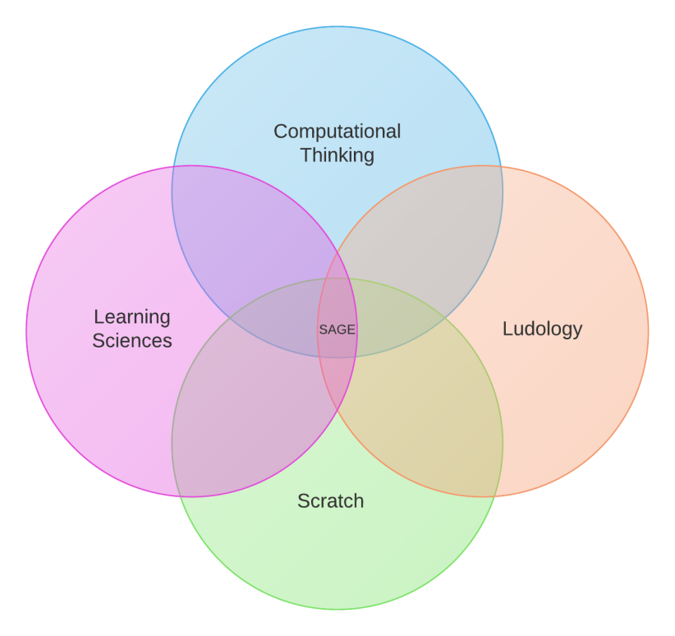
Agenda
Introduction
Choosing a CT Platform for Grades 6-8
Theoretically Grounded GBL
Learning Principles & Tooling Design Tactics
Research Results & Methodology
Conclusion
Acronym Map
Computational Thinking (CT)
Learning Sciences (LS)
Game-Based Learning (GBL)
Self-Determination Theory (SDT)
Cognitive Evaluation Theory (CET)
Educational Data Mining (EDM)
Learning Analytics (LA)
Computer Supported Collaborative Learning (CSCL)
Story-Centered Curricula (SCC)
Design-Based Research (DBR)

Slide 3
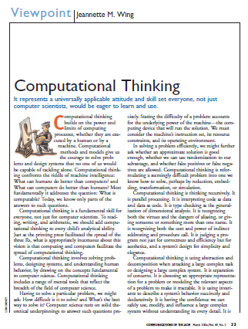
Introduction > Computational Thinking
a universally applicable attitude and skill set everyone, not just computer scientists, would be eager to learn and use
Elements of CT (NSF core)
problem formulation, logically organizing & analyzing data, representing data through abstractions such as models, algorithmically automating solutions, implementing effective solutions optimally
Abstractions are the 'mental' tools of computing. The power of our 'mental' tools is amplified by the power of our 'metal' tools. Computing is the automation of our abstractions.
[Wing]
Computational thinking and thinking about computing

Slide 4

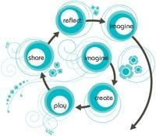

Introduction > CT in K-12
Computer Literacy
Digital Fluency
Computational Thinking
NSF CS10K Project: recruit 10K teachers prepared to teach CS
New 9-12 classes: Exploring Computer Science (ECS) and Computer Science Principles (CSP)
CSTA/ACM K-12 CS Standards: CT interwoven throughout
students can learn thinking strategies such as computational thinking as they study a discipline
[NRC Committee for the Workshops on Computational Thinking]
There is inherently a C (Computing) in STEM. Learning STEM without learning computing is fundamentally inadequate. Learning computing while solving STEM problems, on the other hand, would inevitably foster one's computational thinking ability.
[Hu]
Computational thinking – what it might mean and what we might do about it

Slide 5

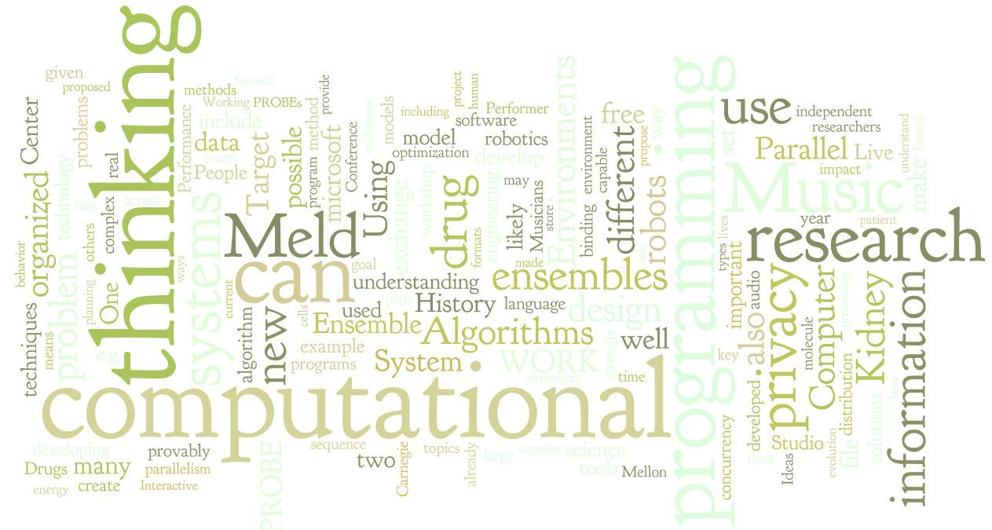
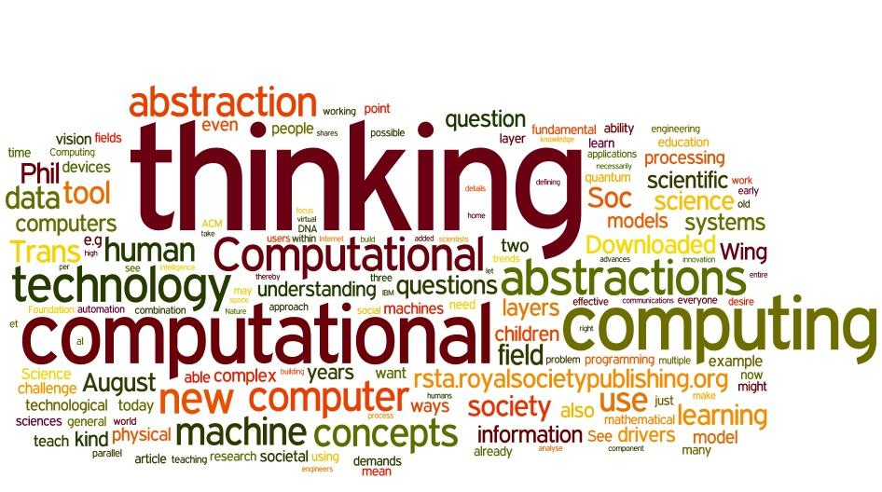
Introduction > CT via GBL
CT → computational doing → situated learning → GBL pedagogy
CT
Versatility bridges domain-specific expertise and technical innovation
Understanding abstractions requires concretization
GBL
Supports diversity of subjects within existing curricula
Interactivity: a multi-way exchange with feedback and invitation to probe deeper
Focus: linkages between CT learning outcomes & game attributes
The more we do in computation, the more capable we are as computational thinkers. Thus, perhaps, it is not computational thinking we should promote, but computational doing at all levels of K-16 education in order for us to better understand the computational potential of the world in which we live. Therefore, whether or not we would be able to "accurately" define "computational thinking" might never be important.
[Hu]
Computational thinking – what it might mean and what we might do about it

Slide 6
Agenda > 2
Introduction
Choosing a CT Platform for Grades 6-8
Theoretically Grounded GBL
Learning Principles & Tooling Design Tactics
Research Results & Methodology
Conclusion
To succeed in today’s Creative Society, students must learn to think creatively, plan systematically, analyze critically, work collaboratively, communicate clearly, design iteratively, and learn continuously. Unfortunately, most uses of technologies in schools today do not support these 21st-century learning skills. In many cases, new technologies are simply reinforcing old ways of teaching and learning.
[Resnick]
Sowing the seeds for a more the creative society

Slide 7



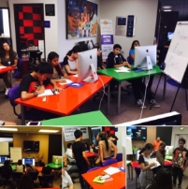
Needs Analysis > Students
Instructionism
Constructionism
Socioculturalism
high ceilings: increasing complexity
Creation of personally meaningful artifacts
innovate
problem-solve
reflect
wide walls: diverse projects, interests, learning styles
Situated activity,
collaborative
communities,
learning embedded in social context
Single speaker,
many listeners,
tests as proof of learning
share
imagine
create
play
low floors: easy starts
Deep learning - learning that can lead to real understanding, the ability to apply one's knowledge, and even to transform that knowledge for innovation - requires that we move beyond "learning about" and moving to "learning to be.“
[Gee]
Good Games + Good Learning

Slide 8
Needs Analysis > Schools & Teachers
Schools
Cogent CT definitions
Economical authoring tools
Age-appropriate pedagogical examples
Teachers
CT learning progressions
Demonstrated CT operation across subjects
Systemic platforms which embed ecosystems of accessible training materials
There is broad recognition that K-12 teachers need training to effectively introduce computational thinking concepts in the classroom.
[Weinberg]
Computational thinking: an investigation of the existing scholarship and research

Slide 9
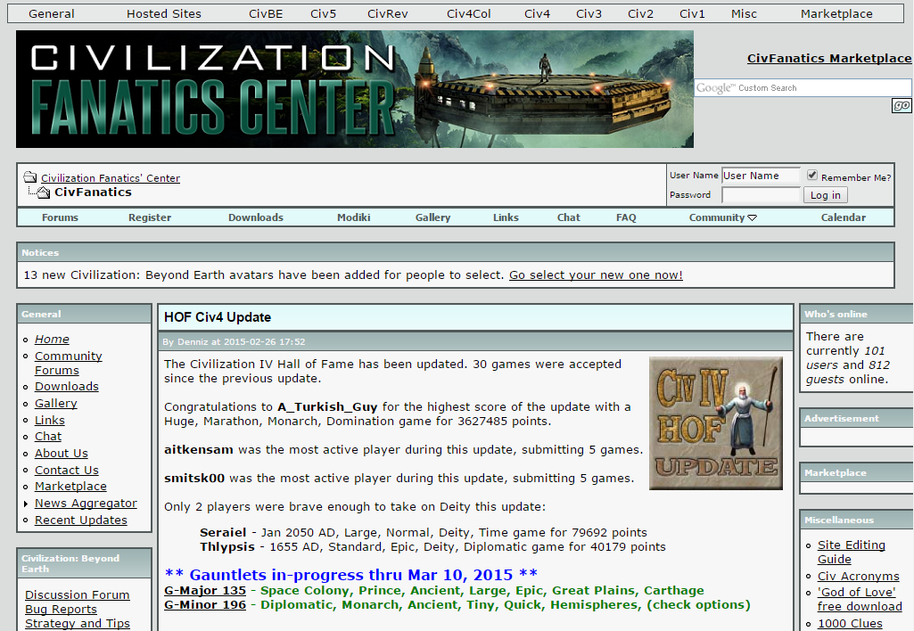
Needs Analysis > Nurturing Affinity Spaces
Characteristics
Low barriers to expression and engagement
Robust facility for creation and sharing creations
Mentoring relationships and knowledge transfer from experts to novices
Good learning and human growth
Nurturing affinity spaces tend to foster a view of expertise as rooted more in the space itself or the community that exists in the space and not in individuals’ heads. “Experts” know that their expertise is always partial and limited, and they draw on the knowledge stored in the community when they need to supplement their individual knowledge or learn new things.
[Gee & Hayes]
Nurturing affinity spaces and game-based learning

Slide 10
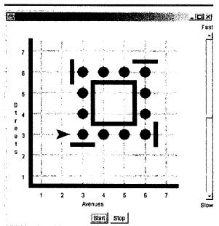
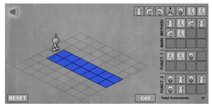
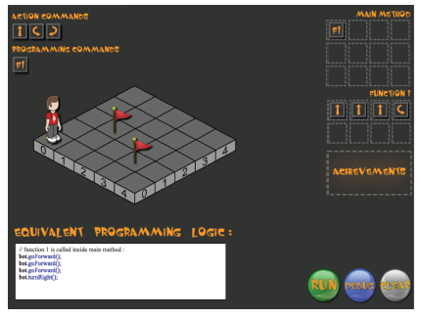
Alternatives > Karel & Cousins
Needs Analysis
Low floors, but low ceilings, narrow walls
Imaginative and playful, but too toy-like with inadequate authoring tools
Textbook learning progressions, but limited embedded training materials
No nurturing affinity space
[A]lthough it may seem obvious to an experienced programmer that there are commonalities between Light-Bot and programming, this link may be much less transparent to novice computer science students.
[Gouws et al.]
Computational thinking in educational activities

Slide 11
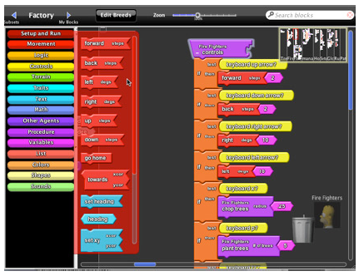
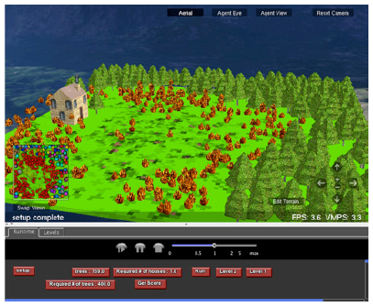
Alternatives > StarLogo TNG
Needs Analysis
High ceilings, but also high floors
Wide walls for science and decentralized systems, but narrow walls for other subjects
Pedagogical examples exist, but often too time consuming to leverage
No nurturing affinity space
This more integrated approach takes more time (at least at first) when compared to didactic approaches (or even more limited simulation-based approaches).... Not only does classroom use... take more time, but the development of such curricular materials also takes time.
[Klopfer et al.]
The simulation cycle: combining games, simulations, engineering and science using
StarLogo TNG

Slide 12
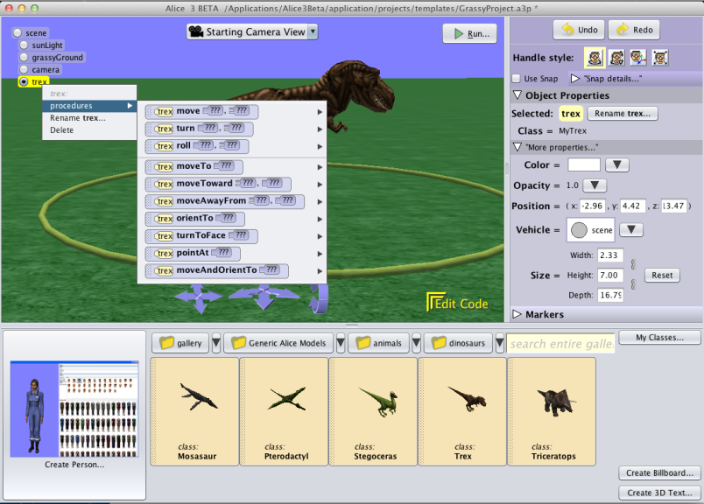
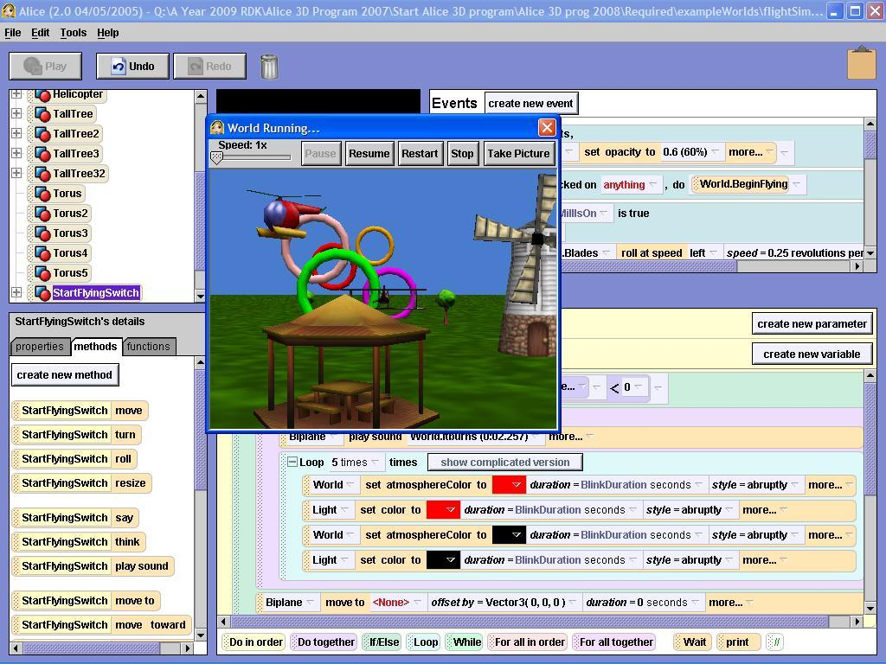
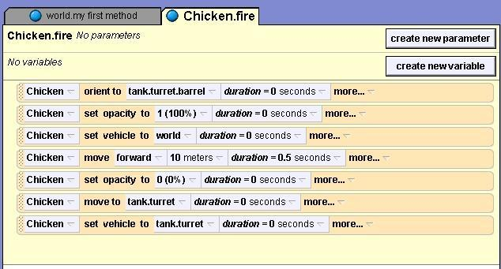
Alternatives > Alice
Needs Analysis
Wide walls and high ceilings, but also high floors
Good tutorials and pedagogical examples, but learning progressions usually designed for undergraduates
Reasonable nurturing affinity space for older learners
Creating an animated movie and learning to program a computer can be fundamentally the same activity... Storytelling is a natural way to introduce the basic concepts behind object-oriented programming.
[Kelleher and Pausch]
Using storytelling to motivate programming

Slide 13

Scratch > Origins
Computer Clubhouse Network
choice & autonomy
active exploration
interest pursuits
relevance
authentic problems
cycles of creation
collaboration & community
instructors as facilitators & mentors
Scratch experts had a high-status position within the local culture... after Scratch was introduced, it comprised 25% of all activities... projects like [Low Rida] eliminate barriers between high and low pop cultures by taking an urban youth culture theme and reinventing it using high-status knowledge, such as software design
[Kafai et al.]
The Computer Clubhouse: Constructionism and Creativity in Youth Communities

Slide 14
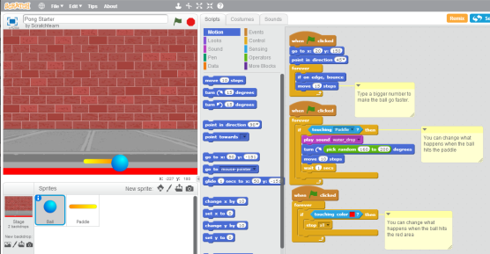
Scratch > Design
Scratch 2.0
Web-based
Very low floors
Easy remixing
Easy collaboration
Easy sharing
Embedded nurturing affinity space
Scratch is like a map because it helps me learn.
[Kafai et al.]
The Computer Clubhouse: Constructionism and Creativity in Youth Communities

Slide 15
Scratch > CT Curricular Framework
Engaging in the creation of computational artifacts prepares young people for more than careers as computer scientists or as programmers. It supports young people’s development as computational thinkers – individuals who can draw on computational concepts, practices, and perspectives in all aspects of their lives, across disciplines and contexts.
[Brennan]
Clubhouse youth discovered and used commands demonstrating the concepts of user interaction, loops, conditionals, and communication and synchronization. The use of less easily discovered concepts such as variables, Boolean logic, and random numbers was less common but increased over time. These findings are especially surprising given the lack of formal instruction and the fact that the mentors had no prior programming experience.
[Kafai et al.]
The Computer Clubhouse: Constructionism and Creativity in Youth Communities

Slide 16
Scratch > Concepts, Practices, Perspectives
Computational Concepts
the concepts designers engage with as they program, such as iteration and parallelism
Computational Practices
the practices designers develop as they engage with the concepts, such as debugging projects or remixing others' work
Computational Perspectives
the perspectives designers form about the world around them and about themselves
Design-based learning is an approach that emphasizes designing (creating things, not just using or interacting with things), personalizing (creating things that are personally meaningful and relevant), collaborating (working with others on creations), and reflecting (reviewing and rethinking one’s creative practices).
[Brennan]
Creative computing: a design-based introduction to computational thinking

Slide 17
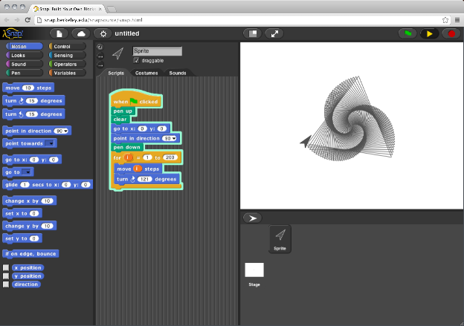
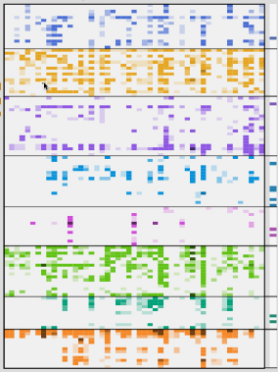
Scratch Tools & Assessment > Snap! & Scrape
Snap!
Scrape
Snap! supports older learners (14-20) by adding named procedures (thus recursion), procedures as data (thus higher order functions), structured lists, and sprites as first class objects with inheritance.
[Harvey et al.]
Snap!: (build your own blocks)

Slide 18





Scratch Tools & Assessment > Scratch Analyzer
Input: .sb2 files
Output: EDM & LA
Scratch Extractor identifies Scratch blocks serialized as JSON and strips irrelevant syntax while preserving hierarchical structure.
Scratch Dispatcher transforms extracted blocks into simple CSVs compatible with recommendation engines built using a variety of big data technologies.
Scratch Traverser follows the hierarchical structure of extracted Scratch blocks and executes a user-
supplied method for each block.
Compressed JavaScript Object Notation
Project, peer, & mentor recommendations
CT concept clustering
Evaluative classification
Scratch Analyzer
Scratch Analyzer
Scratch Analyzer
Scratch Analyzer
Dispatcher
Future
Work
Dispatcher
Dispatcher
Dispatcher
Future
Work
Future
Work
Future
Work
Extractor
Extractor
Extractor
Extractor
Traverser
Traverser
Traverser
Traverser
Models... have even been able to predict... students’ final course grades. This work has been embedded into automated agents that scaffold more effective collaboration and into tools to support instructors in scaffolding their student's collaboration.
[Baker & Siemens]
Educational data mining and learning analytics

Slide 19
Scratch Tools & Assessment > Assessment
1) Project Analysis
Strength: tool-assisted (via Scrape) longitudinal evaluation of concepts
Limitation: intentionality and development process unknown
2) Artifact-Based Interviews
Strength: discuss products and processes, nuanced characterizations
Limitation: time consuming, reliant on memory
3) Design Scenarios
Strength: evaluate critiquing, debugging, extending; process-in-action
Limitation: test-like, time consuming, disconnected from interests
[The] capabilities afforded by a suitable computational environment and toolkits, such as programming languages for computing and modeling languages for noncomputing domains... can increase effectiveness of teachers by synthesizing results from embedded assessments, allowing teachers to monitor progress in real time.
[Weinberg]
Computational thinking: an investigation of the existing scholarship and research

Slide 20
Agenda > 3
Introduction
Choosing a CT Platform for Grades 6-8
Theoretically Grounded GBL
Learning Principles & Tooling Design Tactics
Research Results & Methodology
Conclusion
Game players inhabit that wonderland space where the frame of the game intersects the frame of the real world. Game designers have the supreme pleasure of creating their own rabbit holes, hoping players find their way down inside, in order to create their own meanings. Game designers are the architects, the meaning-makers, the storytellers that make the play of wonderland possible.
[Salen & Zimmerman]
Rules of Play: Game Design Fundamentals

Slide 21
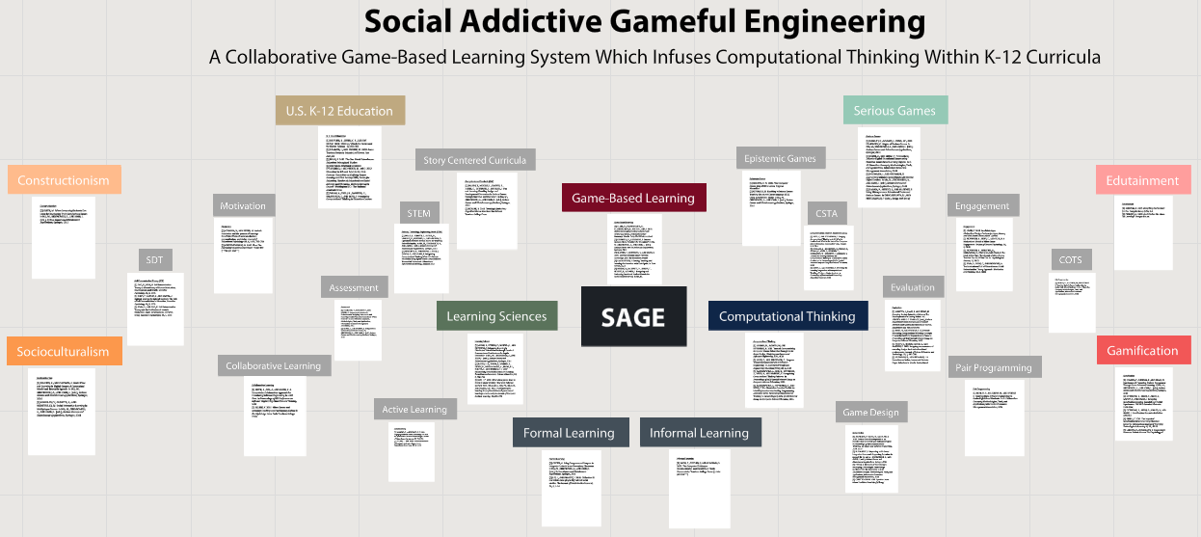
GBL > SAGE Concept Map
[I]t would appear that both novice-friendly IDEs and educational games alike leave something to be desired from the standpoint of sparking lifelong passions for programming. The gamification of programing environments like Alice or Scratch might be one solution.
[Esper et al.]
On the nature of fires and how to spark them when you’re not there

Slide 22
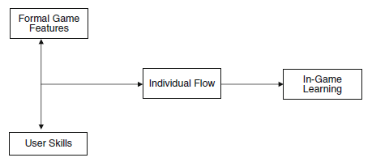
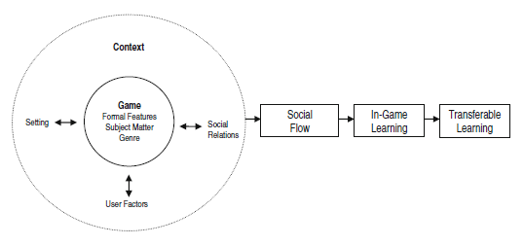
SAGE Theory > Social
Gameflow & Learning
Computer Supported Collaborative Learning (CSCL)
Cooperation: individuals learn and then assemble
Collaboration: learning occurs socially during knowledge construction
Adaptive media which prompts, analyzes, & selectively responds
Cognitive Apprenticeship
Bring cognitive processes into the open for observation and practice
Illustrate power of particular techniques applied in diverse settings
Task complexity increased adaptively to integrate component skills
Social Gameflow & Learning
Designing learning environments is not merely a matter of getting the curricular material right but is crucially also a matter of getting the situated, emergent community structures and practices right.
[Steinkuehler]
Learning in massively multiplayer online games

Slide 23
SAGE Theory > Addictive
Interest
a psychological state; predisposition to reengage particular disciplinary content over time
Flow
(a) a clear sense of what has to be done moment by moment; (b) immediate feedback as to how well one is doing; (c) an intense concentration of attention; (d) a balance between opportunities for action (challenges) and capacity to act (skills); (e) exclusion of irrelevant content from consciousness; (f) a sense of control over the activity; (g) a distortion of sense of time – usually hours pass by in minutes; and (h) a feeling that the activity is intrinsically rewarding, or worth doing for its own sake
Motivation
a complex blend of environment, cognition, affect; interest is motivating, but motivating is not always of interest
Engagement
a learner’s connection to the environment; initiation of action, effort, and persistence in academic tasks; active involvement
[Csikszentmihalyi]
Suffice it to say that the use of term "addiction," when used by professionals in the game industry, does not describe medically pathological behavior. Instead, it refers to engaged and repeated play, to players that enjoy a game and therefore play it more than one time.
[Salen & Zimmerman]
Rules of Play: Game Design Fundamentals

Slide 24
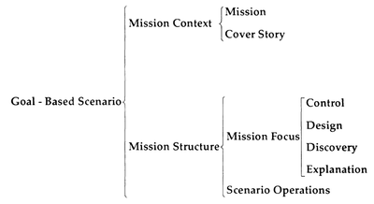


SAGE Theory > Gameful
Learning in Activity
a group, classroom, community, or individual working with authentic objects and technological activity systems
Gameful
goal-oriented, curiosity-driven, failure-fearless, optimistic, and fun
Embodiment
guide learners from immersive action to structured reflection; make unconscious, tacit, contextual knowledge explicit
Scaffolding
learners leverage the help of more knowledgeable agents to support problem-solving & can perform more complex tasks to fuel learning
In contrast to a passive, subject-oriented curriculum, a Story-Centered Curriculum (SCC) can be viewed as a carefully designed apprenticeship-style learning experience in which the student encounters a planned sequence of real-world situations constructed to motivate the development and application of knowledge and skills in an integrated fashion.
[Roger Schank]
Teaching Minds: How Cognitive Science Can Save Our Schools

Slide 25
SAGE Theory > Engineering
Problem-Based Learning
an active approach in which learners collaborate to solve complex, ill-structured problems; learners share knowledge, negotiate among alternative ideas, search for info, and construct principled arguments
Self-Determination Theory (SDT) & Cognitive Evaluation Theory (CET)
promotion of self-motivated and self-determined learning; specific psychological nourishments must be present in activities for them to be inherently enjoyable; competence, autonomy, relatedness
A game is a problem solving activity, approached with a playful attitude.
[Schell]
The Art of Game Design: A Book of Lenses

Slide 26
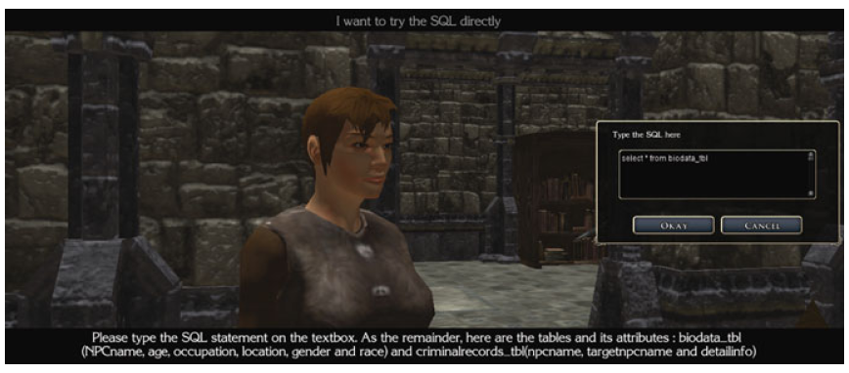
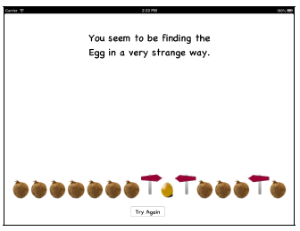
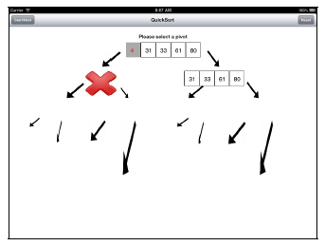
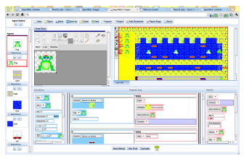
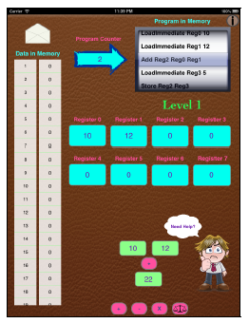
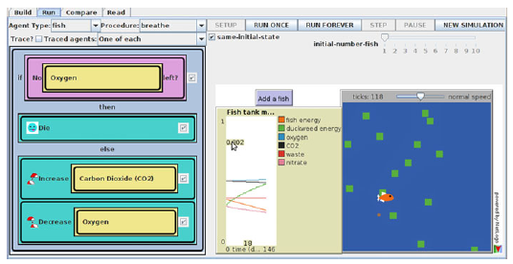
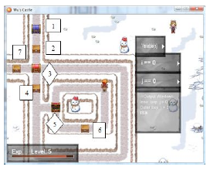
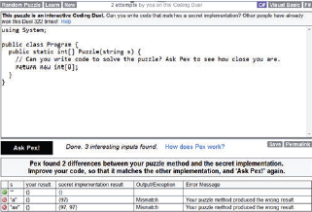
Example CT GBL > Representative Survey
NeverWinter Nights SQL
CS Tablet Apps
AgentWeb
CTSiM
Wu’s Castle
Pex4Fun
CPU
Quicksort
Binary Sort
Most commercial games fall short as platforms for learning because they do not help people articulate and connect their evolving intuitive understandings to more explicit formalized structures that would support transfer of knowledge to other contexts. Games hold the potential, however, to support learners in integrating their tacit spontaneous concepts with instructed concepts, thus preparing learners for future learning through a flexible and powerful foundation of conceptual understanding and skills.
[Clark & Martinez-Garza]
Prediction and explanation as design mechanics in conceptually integrated digital games

Slide 27
Agenda > 4
Introduction
Choosing a CT Platform for Grades 6-8
Theoretically Grounded GBL
Learning Principles & Tooling Design Tactics
Research Results & Methodology
Conclusion
[A]n educational game should prepare the base for scaffolding strategies through delivering feedback to students encouraging them on correct use of CS concepts... We need to define what strategies, such as modelling, coaching, scaffolding, need to be applied in order to transfer skills gained from game-play into learning traditional programming... Which tasks are more appropriate for game-play and which tasks are more appropriate for instructors?
[Kazimoglu et al.]
Understanding computational thinking before programming: developing guidelines for the design of games to learn introductory programming through game-play

Slide 28


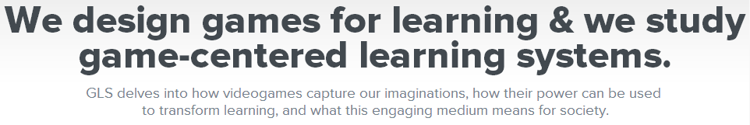
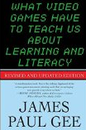

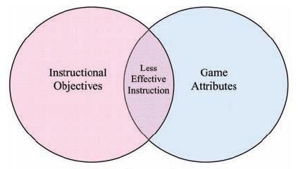
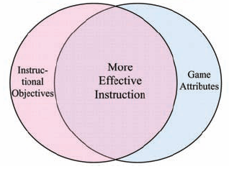
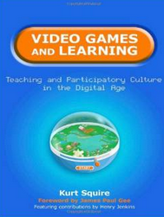



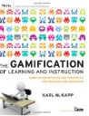
CT & GBL Learning Principles
Engagement
Self-Determination Theory
Learning in Activity
Serious Games
Gamification
[Wilson et al.]
“Playing the game made you pay attention and read everything.”
[teenage student, quoted by Squire]
Replaying history: learning world history through playing Civilization III

Slide 29
SAGE Principles > Social
Nurturing Affinity Space Principle
SAGE affiliates students by enveloping them in shared endeavors that require cross-functional collaboration, thereby creating multiplicities of respected expertise.
Social Gameflow | CSCL | Cognitive Apprenticeship
What people have a passionate affinity for in an affinity space is not… the other people in the space but rather the passionate endeavor or interest around which the space is organized. The passion that fuels an affinity space can, however, lead to quite different ways of behaving, depending on how the other features… of the affinity space are implemented. While people eventually may come to value their fellow members as one of the primary reasons for being in the affinity space, the shared passion is foregrounded as the reason for being there.
[Gee & Hayes]
Nurturing affinity spaces and game-based learning

Slide 30
SAGE Principles > Addictive
Regime of Competence Principle
SAGE induces flow and cultivates engagement by presenting pleasantly frustrating challenges that stretch the competencies of each individual student.
Flow | Interest | Motivation | Engagement
Vygotsky argues that players accept the rules of the game not in order to restrict pleasure, but
instead to maximize it. “To observe the rules of the play structure promises much greater pleasure from the game than the gratification of an immediate impulse.” Through mechanisms of restraint and the withholding of immediate impulses, games transform the player’s experience of constraint into one of abundant pleasure.
[Salen & Zimmerman]
Rules of Play: Game Design Fundamentals

Slide 31
SAGE Principles > Gameful
Situated Meaning Principle
SAGE does not assemble CT concepts disconnected from gameplay, but instead envelopes students in gameful environments in which concept exploration emerges as narratives unfold.
Learning in Activity | Embodiment | Scaffolding | GBS | SCC
[In] some types of instructional games, the movement from one level to another with increasing difficulty and the need to apply more skill to master the new level is similar to the educational concept of scaffolding... The technique of scaffolding and the use of levels in games provide educational advantages but also maintain interest in the game as a player moves from level to level having different experiences and achieving success as he or she progresses toward the ultimate goal.
[Kapp]
The Gamification of Learning and Instruction

Slide 32
SAGE Principles > Engineering
Explicit Information On-Demand & JIT Principle
SAGE explains directly only when students eagerly seek or desire information and have accrued the experience and motivation imperative to consume that information lucidly.
Problem-Based Learning | SDT | CET
When you have played a video game for a while, something magical happens to the texts
associated with it. All of a sudden they seem lucid and clear and readable.
[Gee]
What Video Games Have to Teach Us about Learning and Literacy

Slide 33
GBL Design Tactics
Game system design is a kind of metagame design. A game system designer designs the structure within which other game designers will create games. The “rules” of the system are the physical qualities of the game system components; the “play” that takes place is game design itself, resulting in sets of rules that make use of the game system. This kind of process requires that the game system designer give up a significant degree of control, as other player-designers decide how the game system will be used in actual games. But this loss of control is ultimately what is so satisfying about designing game systems: as a platform for player-driven creativity, a game system is a catalyst for truly transformative and emergent play.
[Salen & Zimmerman]
A majority of the research... used games in which a number of game attributes were embedded within the game... To truly understand the relationships that exist, we must first explore these game attributes in isolation... The ultimate goal is to encourage this desired learner state by using certain information with certain game attributes in order to produce specific learned knowledge, skills, and attitudes.
[Wilson et al.]
Relationships between game attributes and learning outcomes: review & research proposals

Slide 34
SAGE Design Tactics > Social
Role provisioning
Peer-visible explanation facilitation (elected & prompted)
Script sharing & embedded chat (elected & event-driven)
Nurturing Affinity Space Principle
Social Gameflow | CSCL | Cognitive Apprenticeship
Affinity spaces tend to encourage a view of learning where the individual is proactive, self-propelled, and engaged with trial and error and where failure is seen as a path to success. This view of learning does not exclude asking for help, but help from the community is never seen as replacing a person’s responsibility for his or her own learning.
[Gee & Hayes]
Nurturing affinity spaces and game-based learning

Slide 35
SAGE Design Tactics > Addictive
Game mechanic blocks (GMB) with adaptive constraints
Configurable block point system integrated with GMB & levels
Achievement system
Regime of Competence Principle
Flow | Interest | Motivation | Engagement
The real world doesn’t offer as easily the carefully designed pleasures, the thrilling challenges, and the powerful social bonding afforded by virtual environments. Reality doesn’t motivate us as effectively.
[McGonigal]
Reality is Broken: Why Games Make Us Better and How They Can Change the World

Slide 36
SAGE Design Tactics > Gameful
Integrated storyboard and leveling controls
Palette/block restriction system supportive of narrative structure
Block crippling mechanism facilitating endogenous stories
Situated Meaning Principle
Learning in Activity | Embodiment | Scaffolding | GBS | SCC
A realistic story, at the core of each SCC, provides a meaningful, motivating role for the student, designed to ensure that the student faces exactly the right progression of challenges to stretch and build his or her abilities.
[Roger Schank]
Teaching Minds: How Cognitive Science Can Save Our Schools

Slide 37
SAGE Design Tactics > Engineering
Context-aware, event-driven, JIT CT knowledge system
Embedded, on-demand instruction modules
Support for diagnostics & performance measurements
Explicit Information On-Demand & JIT Principle
Problem-Based Learning | SDT | CET
Crafting a motivational game using Self-Determination Theory and its subcomponents, requires that players feel that they are autonomous and in control of their own actions, that they experience competence in achieving the tasks within the game space, and they feel somehow related to others who either are playing the game with them at the moment or who have played before, for example, a leaderboard or tokens or messages left by previous players.
[Kapp]
The Gamification of Learning and Instruction

Slide 38
Agenda > 5
Introduction
Choosing a CT Platform for Grades 6-8
Theoretically Grounded GBL
Learning Principles & Tooling Design Tactics
Research Results & Methodology
Conclusion
There seems to be a laissez faire culture within computer science education that accepts research and evaluation studies that lack conceptual and methodological rigor... Evidence of robust research designs in the computational thinking literature is non existent... By following the established educational research standards as well as the recommendations set forth by researchers who have examined the body of literature in the field..., the [CS] education community will slowly amass the evidence it needs to establish its place in the K-12 curriculum.
[Weinberg]
Computational thinking: an investigation of the existing scholarship and research

Slide 39
Research > Previous Results
Games make learning programming more enjoyable and motivational to students than a traditional teaching environment
Low participation, lack of empirical evidence
Most studies use exogenous (drill & practice) games or assessments on existing visual programming languages
Many affective outcome studies, but limited depth in skill-based and cognitive outcome research
[Eagle & Barnes; Yeh; Kazimoglu; Long; Muratet et al.]
In conclusion..., [existing GBL approaches] offer the potential for student learning using games technologies, but predominantly they support conceptual learning of topics and information, and do not address the practical skills and contextual knowledge necessary to become effective programmers.
[Kazimoglu et al.]
Understanding computational thinking before programming: developing guidelines for the design of games to learn introductory programming through game-play

Slide 40
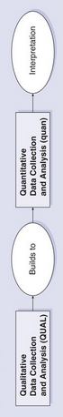
Research > Methodology
Design-Based Research
study learning in environments that are designed and systematically changed by the researcher; iterative design enables the advancement of new theory and practice with the aim of improving the learning for study participants
Exploratory Sequential Mixed Methods
explore participants views in a qualitative phase; analyze data and identify variable to include when constructing instruments that fit theory and population sample; follow-up with quantitative phase
Scale-Down
study from a systemic perspective in natural environments; analyze to develop hypotheses for improvement by identifying nearly decomposable systems; modify the design and reintegrate; observe full system again in natural context
[Creswell]
Quality studies employ systematic designs and are underpinned by explicit theoretical or conceptual frameworks to address significant questions that will contribute to the knowledge base. Furthermore, controls for counterfactuals and threats to internal validity that threaten causal connections are vital components of studies that aim to make causal claims.
[Weinberg]
Computational thinking: an investigation of the existing scholarship and research

Slide 41
Research > Assessment Instruments
CT Score: 4-point Likert
CT Pattern Quiz: measure of transfer
CT Pattern Graph: particular vs. canonical solutions
Progression of Early CT (PECT): framework for assessing CT in grades 1-6
CT Problem Solving Inventory (CTSPI): quantifies usage of computational strategies when solving problems
Computer Anxiety Rating Scale (CARS): 20-item affective instrument
[Gouws et al.; Basawapanta et al.; Seiter & Foreman; Booth]
The digital context of video games affords a remarkable opportunity to track the decision paths that players follow… The need for traditional education researchers to document the results of interventions can lead to the dismissal of contextual information irrelevant to understanding learning. Because of their ability to trace the paths players follow between intended and actual game play, game researchers can create models to describe how the process actually unfolds in complex domains.
[Schaffer]
Afterword: games and the future of education research

Slide 42
Agenda > 6
Introduction
Choosing a CT Platform for Grades 6-8
Theoretically Grounded GBL
Learning Principles & Tooling Design Tactics
Research Results & Methodology
Conclusion
Computers have enormous impact on the way we live, think, and act. It is hard to overestimate their importance in the future. In fact, many believe that the true computer revolution will not happen until everyone can understand the technology well enough to use it in truly
innovative ways.
[CSTA Standards Task Force]
K–12 Computer Science Standards

Slide 43
CT > Essential 21st Century Skill
Computational thinking goes beyond computer literacy, which is the efficient use of technology, and also beyond fluency, which is focused on skills that enable to use technology. Computational thinking includes analytical skills that enhance how one approaches a problem and an appreciation for how computing can augment a person’s abilities and enhance efficiency.
[Weinberg]
computer literacy
digital natives
CT
FITness
digital fluency
1980
2015
[I]nstead of being limited as we are in mechanical or electrical engineering by tolerances and that sort of thing, we are only limited by the things we can think about, by the complexity that we can control in our minds. In other words, [CT] invents the abstractions that it manipulates.
[NRC Committee for the Workshops on Computational Thinking]
Report of a workshop on the scope and nature of computational thinking

Slide 44
CT > Rational for K-12 Standards
Encourage equitable access to technological skills and devices by enhancing personal empowerment through the application of CT in daily lives
Raise student interest in information technology, computer science, other technologically oriented professions
Maintain and enhance national economic competitiveness
[NRC Committee for the Workshops on Computational Thinking]
[CT] is comparable in importance and significance to the mathematical, linguistic, and logical reasoning that society today agrees should be taught to all children... [CT] is a grand vision to guide computer science educators, researchers, and practitioners as we act to change society's image of the field.
[Wing]
Computational thinking

Slide 45
SAGE > Future Work
Final project: employ 1-2 design tactics to begin tooling Scratch
Long-term: cultivate a collaborative ecosystem of game-type innovation which aligns game attributes with CT learning outcomes
SAGE in Scratch
GBL theory → learning principles → design tactics → implementation → design-based research → empirical results
We shouldn’t “teacher-proof” curricula so that it can be tested; instead, we should create compelling materials that address teachers’ needs and inspire them to teach creatively and effectively.
[Squire]
Video Games and Learning: Teaching and Participatory Culture in the Digital Age

Slide 46
Tooling Scratch
Designing a Collaborative Game-Based Learning System to Infuse Computational Thinking within Grade 6-8 Curricula
Jeff Bender | COMS E6123 Presentation | 3/3/2015

